Slide 1
CSE 3207 Mathematical Analysis for COmputer Science
Mohammad Hasan
Lecturer
Dept. Of CSE
BAUST,Saidpur

Slide 3
Lesson Objectives
Review of probability, random variable and its probability distribution

Slide 4
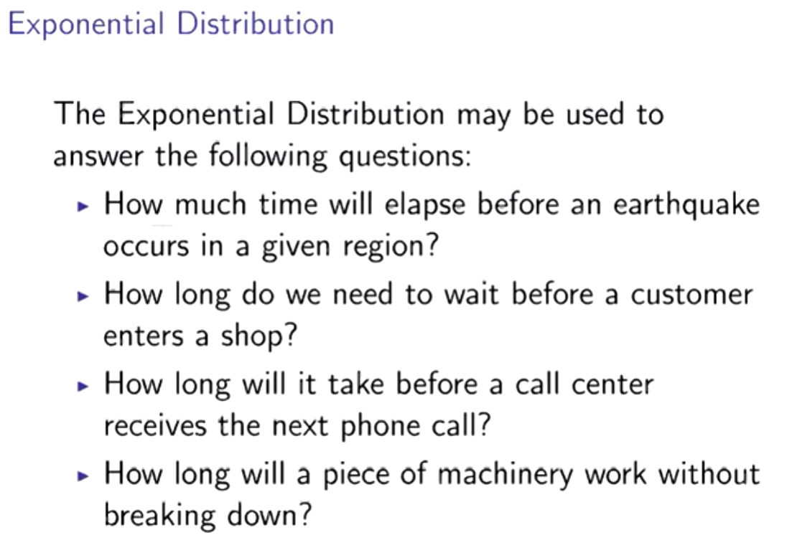

Slide 5
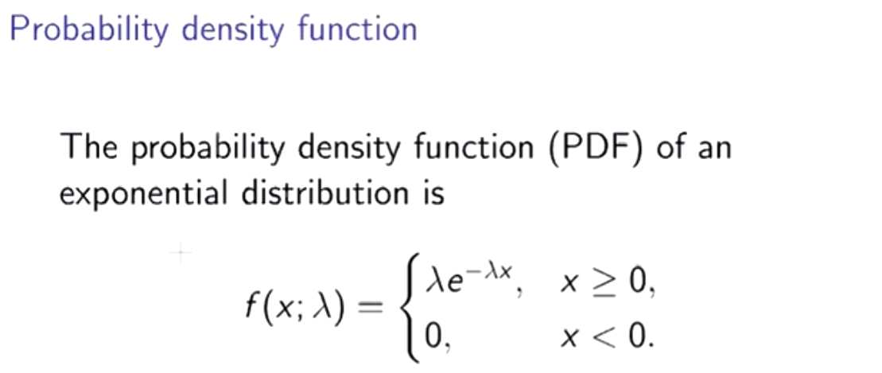
d

Slide 6
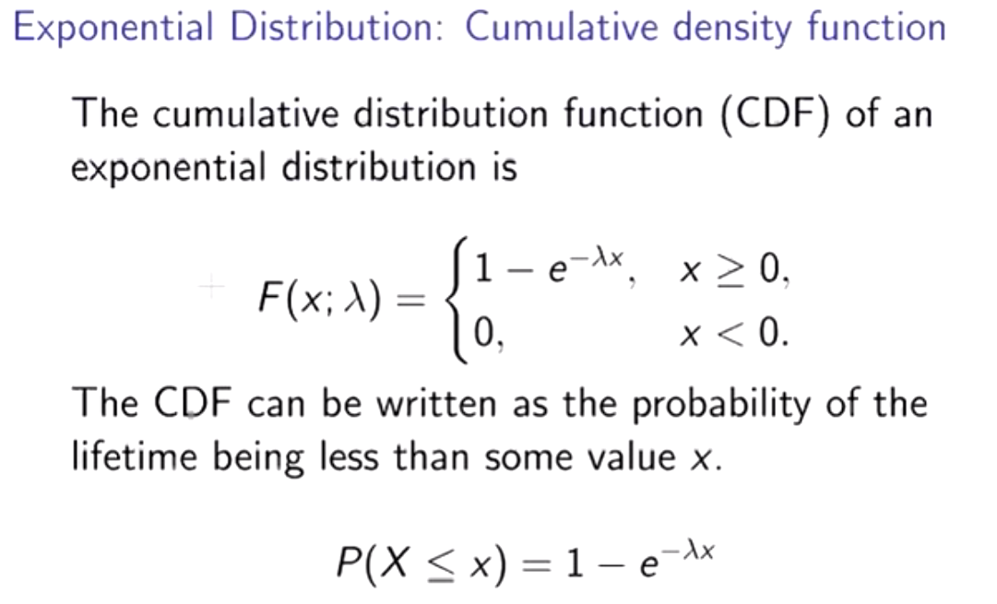

Slide 7
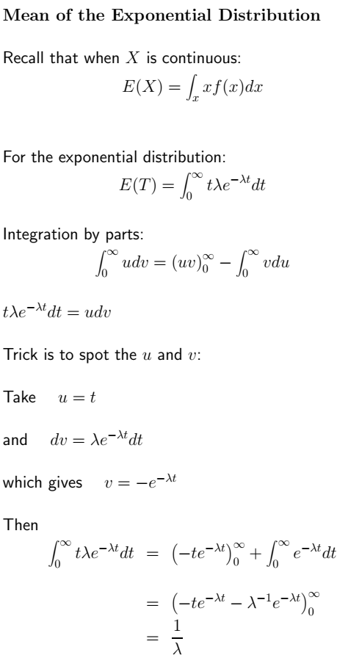

Slide 8
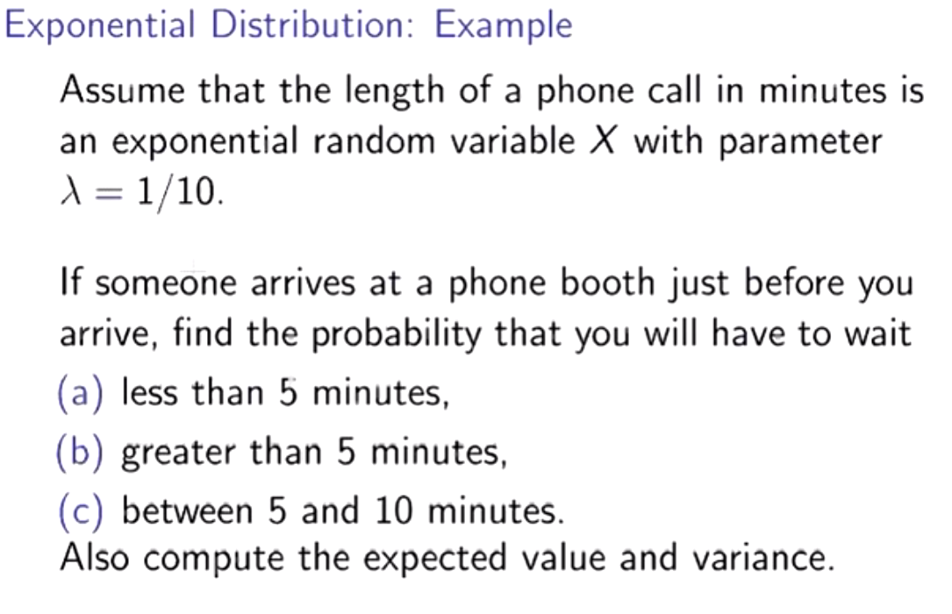

Slide 9
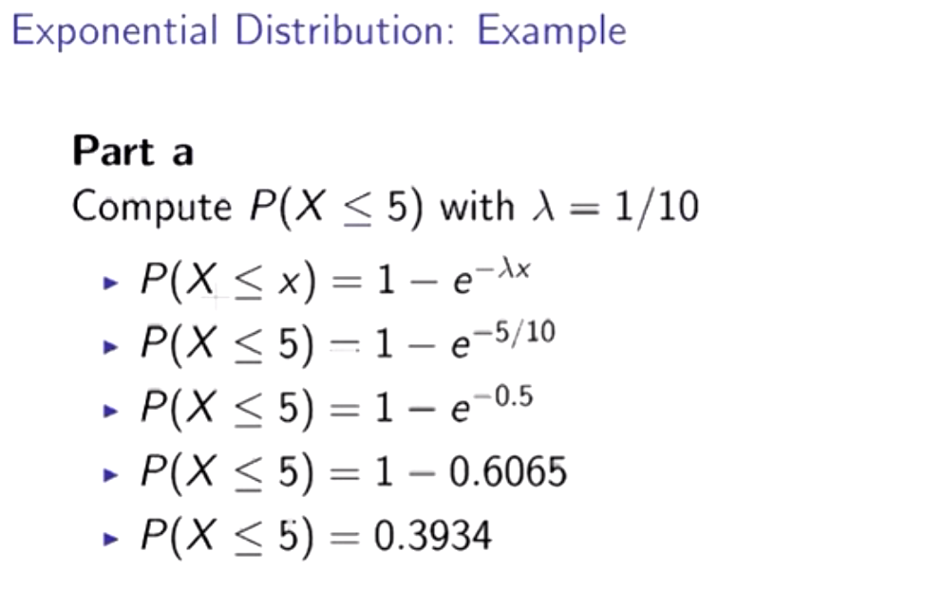

Slide 10
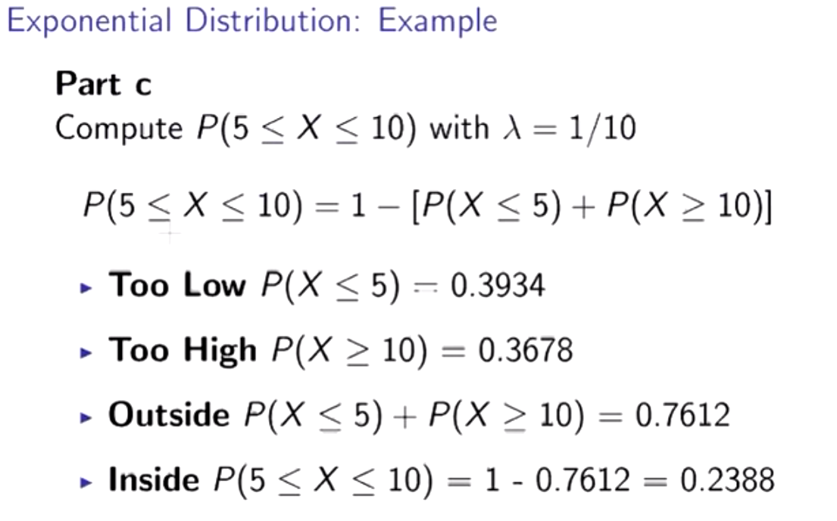

Slide 11
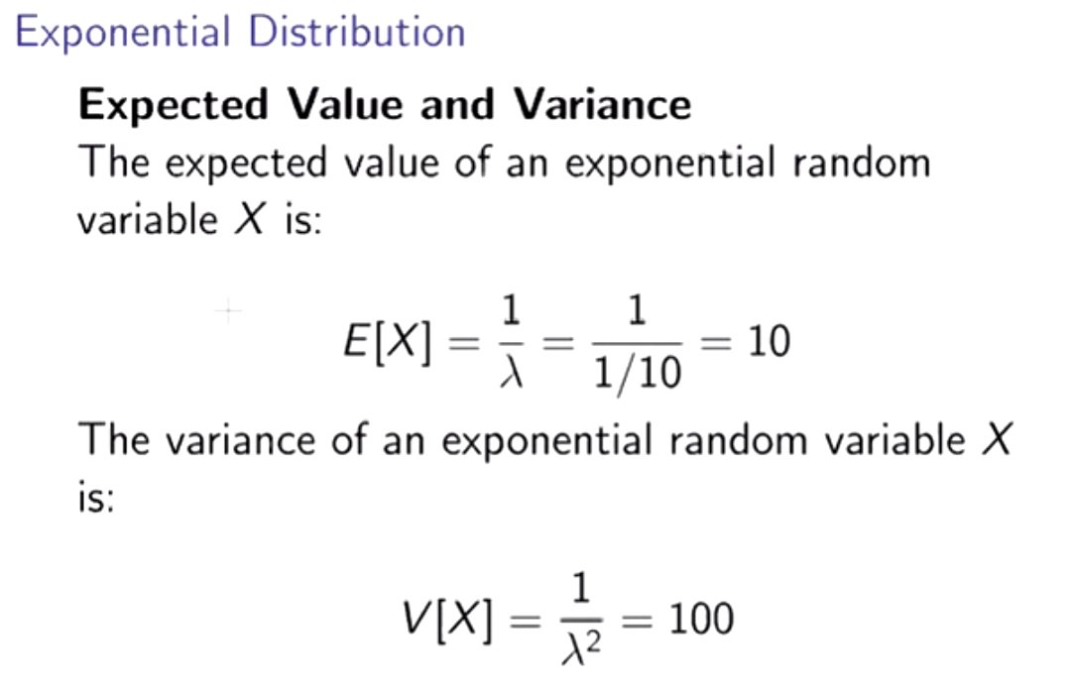

Slide 12
Poisson Distribution
See Class Lecture

